Slide 1
Substitution Method with Caesar Chiper as Secure Data Storage
Group 8
Jasmine Nabila Novel
Muhammad Alif Farhan
4SC4

Slide 2
Background

Slide 3
Substitution Encryption
The substitution password is a type of encryption method in which each unit of light text is replaced by encrypted text with a regular system This method is done by replacing each letter of the original text with the other letter as a passphrase that has been defined before by the key algorithm

Slide 4
Caesar Chiper
Caesar's name was taken from Julius Caesar, who according to Suetonius's book The Life of the Twelve Caesar, used this code with three shifts, to send messages containing secrets or military tactics Caesar cipher is one type of cipher substitution that makes up the cipher by switching characters on plaintext to exactly one character on the chipertext.

Slide 5
Techique and Analysis of Caesar Chiper
Formula Encryption :
X= ( Y + K ) mod 26
Formula Decryption :
Y = (X - K ) mod 26
X = PlainText
Y = ChiperText
Mod 26 = Alphabet 26 K = Key

Slide 6
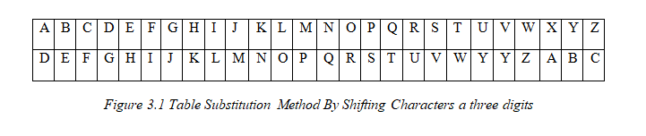
1. Shifting Characters a three digits
For Example : Here is an example of using Caesar Cipher with a large shift of 3 characters. With the value of the shift, obtained table shift value of Caesar Cipher as follows:
BERMAIN SEPAKBOLA
EHUPDLQ VHSDNEROD

Slide 7
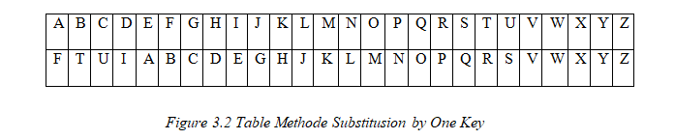
2. By Using One Key
Use key “FTUI”

Slide 8
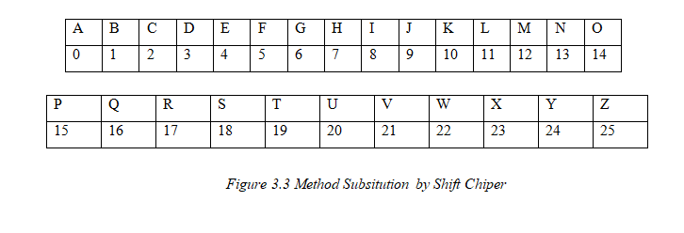
3. By Using Shift Chiper
Shift Ciphers work by using the modulo operator to encrypt and decrypt messages. The Shift Cipher has a key K, which is an integer from 0 to 25.

Slide 9
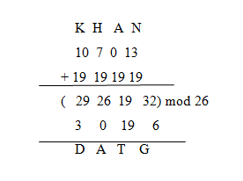
How to Encrypt :
For Example : Shift Cipher with key K=19 for our message encrypt the message "KHAN", as follows:​

Slide 10
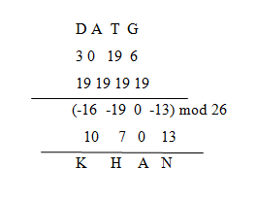
How to Decrypt :

Slide 11
Advantages and Disadvantages
Very popular in his time julius caesar kingdom for his soldiers
Easy to learn
Easy to Solve
The security level is very low
Keyword-breaking techniques can be done by checking all the existing keys that amounted to 26.
very rarely used such encryption in this era

Slide 12
Conclussion and Suggestion

